Slide 1
BASIS OF CHARGE OR RESIDENTIAL STATUS

Slide 2
INTRODUCTION
Tax is levied on total income of assessee. Under the provisions of Income-tax Act, 1961 the total income of each person is based upon his residential status.
Section 6 of the Act divides the assessable persons into three categories : (i) Ordinary Resident; (ii) Resident but Not Ordinarily Resident; and (iii) Non-Resident.

Slide 3
MEANING OF RESIDENTIAL STATUS
Residential status is a term coined under Income Tax Act and has nothing to do with nationality or domicile of a person. An Indian, who is a citizen of India can be non-resident for Income-tax purposes, whereas an American who is a citizen of America can be resident of India for Income-tax purposes. Residential status of a person depends upon the territorial connections of the person with this country, i.e., for how many days he has physically stayed in India.

Slide 4
IMPORTANT POINTS TO BE NOTED
Residential Status in a previous year.
Duty of Assessee.
Dual Residential Status is possible.
Same Residential Status for all sources of income.

Slide 10
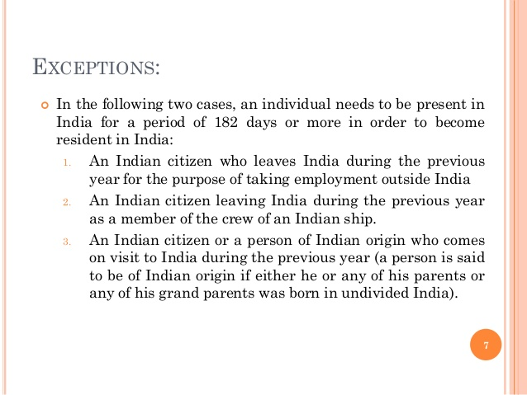

Slide 13
At a glance
ORDINARY RESIDENT
ORDINARY RESIDENT = satisfying any one of conditions given u/s 6(1) + satisfying both the additional conditions of sec 6(6)(a)&(b)
NON-ORDINARY RESIDENT
NON-ORDINARY RESIDENT = satisfying any one of conditions given u/s 6(1) + not satisfying any one or both the additional conditions of sec 6(6)(a)&(b)

Slide 18
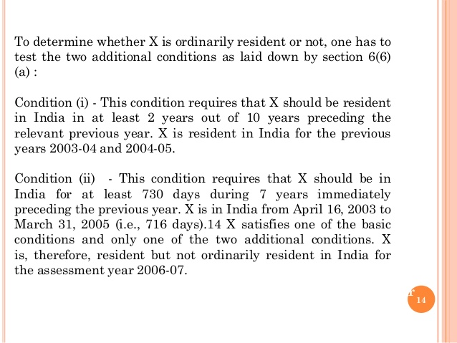

Slide 26
Basis of determination of residential status
PERSON | BASIS FOR RESIDENTIAL STATUS
INDIVIDUAL | Stay in India
HUF | Control and management of affairs + stay of karta in India
FIRM | Control and management of affairs
COMPANY | Place of effective management + place of Incorporation
AOP/BOI | Control and management of affairs
LOCAL AUTHORITY | Control and management of affairs
OTHER PERSONS | Control and management of affairs

